Slide 1
Machine Learning Mini Project

Slide 2
Name:
Sapna Sunil Rokade(311)
Reshma Suresh Nikam(326)
Pair No.:16
Project Name :
Classification of Iris plant

Slide 3
ABSTRACT
Classification is one of the most important approach of machine learning. Main task of machine learning is data analysis. classification and regression algorithms.
In this paper two methods are explained in detail. Implementation is done using iris dataset
1.Support Vector Machine(SVM)
2. K-Nearest Neighbor(KNN)
We have found that SVM classifier gives best accuracy compared to KNN.

Slide 4
INTRODUCTION
The dataset for this project originates from the UCI Machine Learning Repository.
The aim is to classify iris flowers among three species (setosa, versicolor, or virginica) from measurements of sepals and petals' length and width.
The iris data set contains 3 classes of 50 instances each, where each class refers to a type of iris plant.
The objective of this project is to predict the species given the four features of an iris flower.

Slide 5
K-Nearest Neighbor(KNN) Algorithm :
simplest Machine Learning algorithms based on Supervised Learning technique.
K-NN algorithm assumes the similarity between the new case/data and available cases and put the new case into the category that is most similar to the available categories.
K-NN algorithm can be used for Regression as well as for Classification but mostly it is used for the Classification problems.

Slide 6
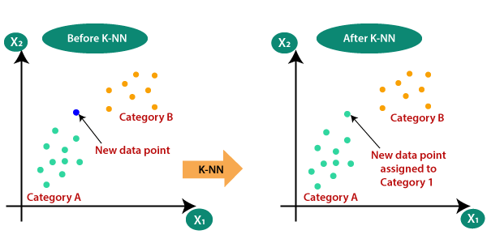
KNN

Slide 7
pport vector machine(SVM) :
Support Vector Machine(SVM) is a popular classification technique.
Support vector machine(SVM) is a supervised machine learning algorithm .
Its high generalization ability makes it to be used in many fields of classification successfully.
Support Vector Machine

Slide 8
SVM

Slide 9
OPTIMAL SOLUTION
To get optimal solution for classification of iris plant we used two algorithm and performed experiment, after that we compared them by using Accuracy criteria.
Algorithm | Accuracy
K-Nearest Neighbor(KNN) | 98.83%
Support vector machine(SVM) | 96.66%

Slide 10
CONCLUSION
In this Mini Project we review two machine learning methods and their applicability to the problem of classification of iris plant.
Therefore optimal solution i.e. optimal classification algorithm is K-Nearest Neighbor(KNN) Algorithm which gives more accuracy and less time as compared to Support vector machine(SVM) Algorithm.

Slide 11
Thank You…

